Slide 1
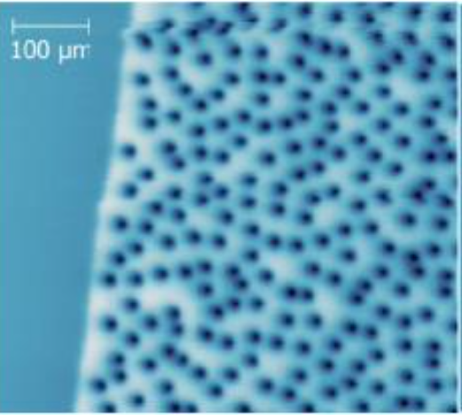




$$\vec{J}×\vec{B}$$
screening
currents
Dissipation (Pair Scattering)
Non-super
conducting
(a)
(b)
$$\vec{J}×\vec{B}$$
$$U_{pin}$$
$$F_{pin}$$
(c)
(d)
Notes:
flux lines have a non-superconducting core
consists of a normal conducting core surrounded by screening currents

